Slide 1
INTERNET COMPUTING PROJECT
Group 8:
Adil Nawaz
Gurman Sekhon
Syed Atif
Lubna Al Rifaie

Slide 2
PROJECT OVERVIEW
Providing educators and faculty members with an advanced suite of tools for tracking:
Student Achievement, Updating Grades, Calculating Final Scores
Developed using SQL, HTML, PHP, and supported by Apache
Search, Delete, Update
Notes:
Introduction (1.1 and 1.2) Gurman

Slide 3
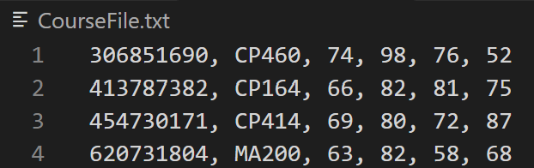
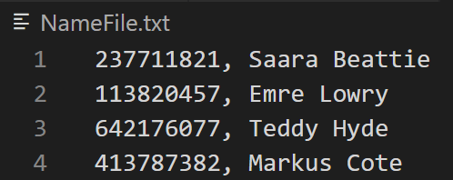
REQUIREMENTS ANALYSIS CONTINUED…
The two inputted files will adhere to the format below.
CourseFile.txt:
Student ID
Course Code
Test 1
Test 2
Test 3
Final Exam
NameFile.txt:
Student ID (max length 9 bytes)
Student Name (max length 20 bytes)
Notes:
lubna

Slide 4

Grade Calculation Verification
ST494 Final Grade Calculation: (70 ✖ 0.20) ➕(95 ✖ 0.20) ➕(54 ✖ 0.20) ➕(62 ✖ 0.4) = 68.6 14 ➕ 19 ➕ 10.8 ➕ 24.8 = 68.6
ST259 Final Grade Calculation: (93 ✖ 0.20) ➕(54 ✖ 0.20) ➕(51 ✖ 0.20) ➕(57 ✖ 0.4) = 62.4 18.6 ➕ 10.8 ➕ 10.2 ➕ 22.8 = 62.4
Final grades are correctly calculated
Notes:
lubna

Slide 5
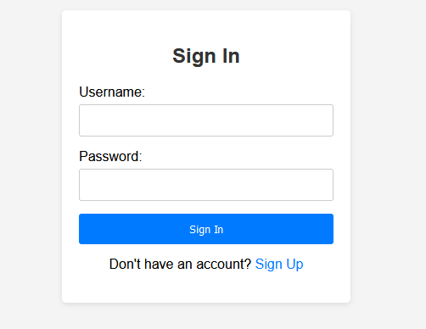
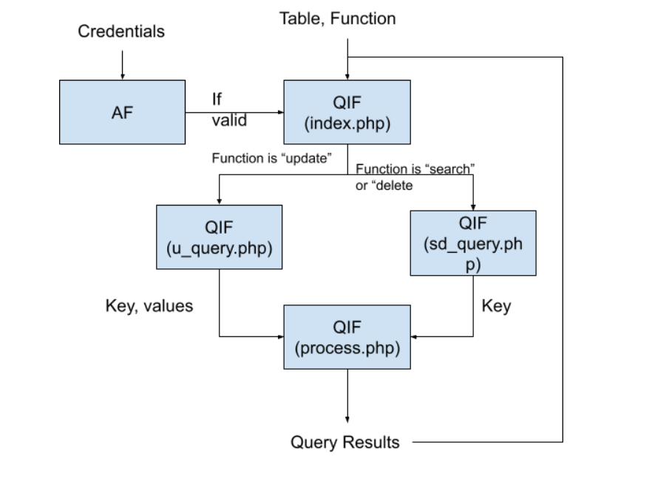
Software Design Description
& Implementation
Frontend
Begins with a secure login page
Querying Interface Frontend (QIF)
Allows user to select function, and enter values accordingly
Notes:
3.1.1 Component Interfaces syed

Slide 6
Software Design Description & Implementation
Backend
Use MySQL DBMS
“Mysqli” API to connect PHP to MySQL
Authentication Backend
Querying Backend
Notes:
3.2.1 Component interfaces syed

Slide 7
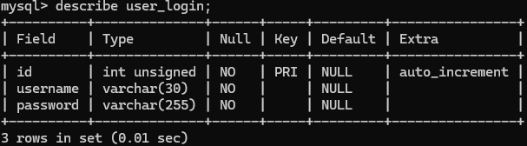
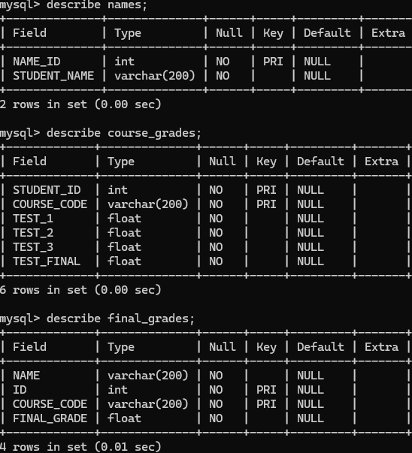
Database
Four distinct database tables
User Login Table
Stores username and password for each user
Names Table
Establishes a critical link between student IDs and their respective names
Course Grades Table
Records each student's grades within specific courses
Final Grades Table
Emerges as a culmination of this data
Notes:
4. Database lubna

Slide 8
Demonstration!
Notes:
syed

